Slide 1
OSH INTERNATIONAL MEDICAL UNVERSITY
Portfolio
Hello! I’m Samatbek Turdaliev
I’m instructor of the discipline Internal Disease at MF of OIMU
My slogan:
Never give up!

Slide 2
Personal information
I studied at the Medical Faculty of Osh State University from 2008 to 2014.
In 2017 I completed my clinical residency in therapy.
Since 2017 I have been working as a teacher at the International Medical Faculty of Osh State University.
In 2018 was specialised as a doctor of ultrasound diagnostics.
Since 2019, I have been the vice dean by practice of students.
Areas of interest: Clinical medicine, internal medicine, cardiology and preventive medicine.

Slide 3
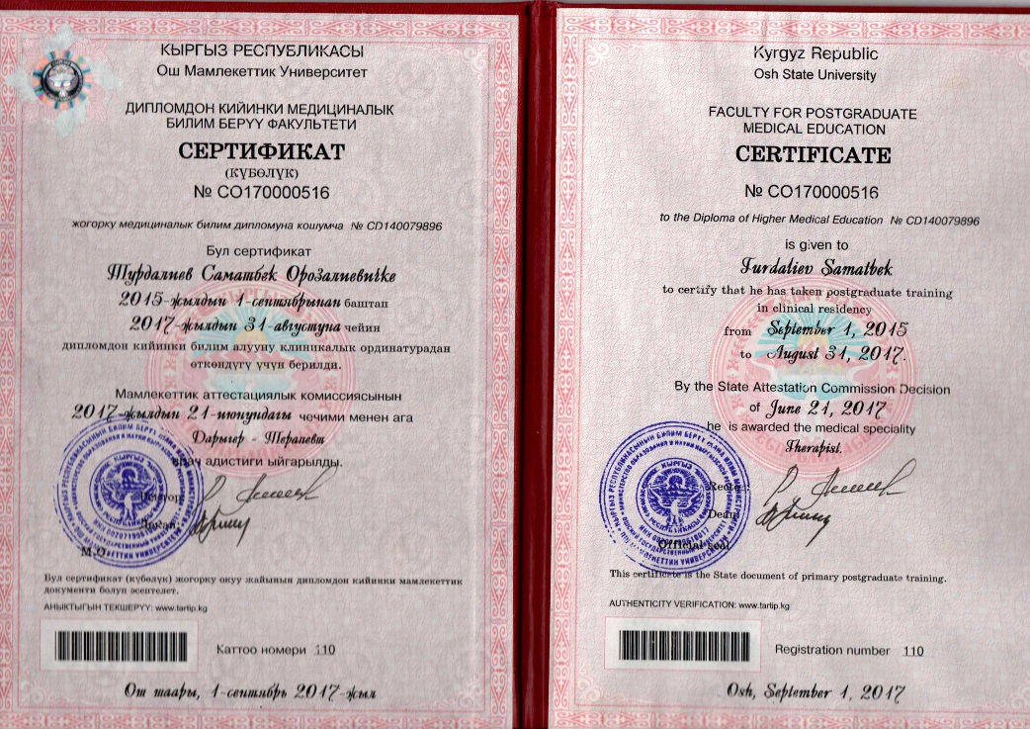
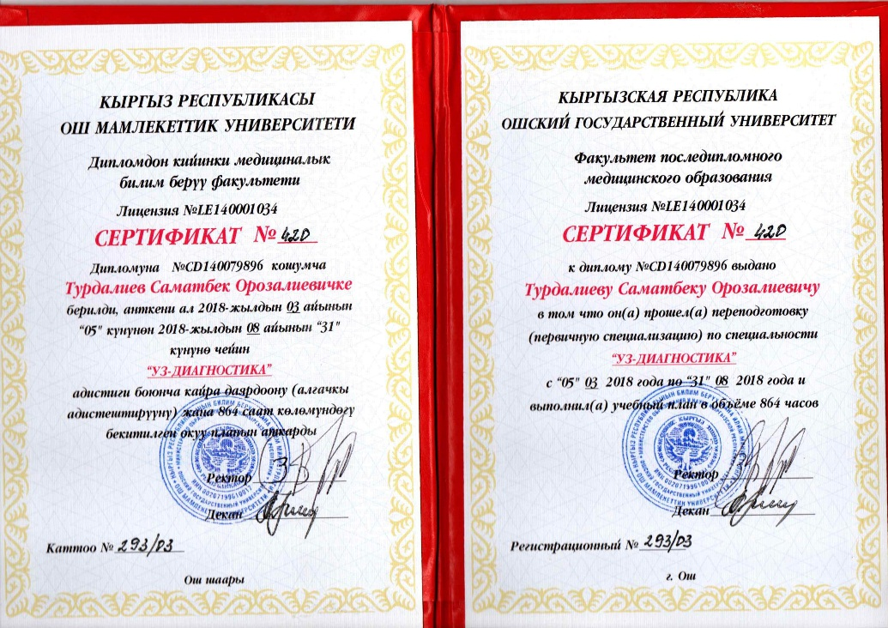
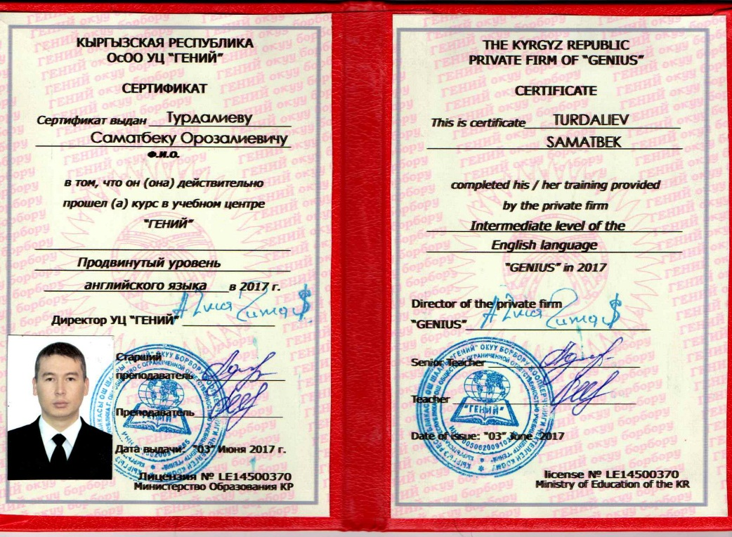
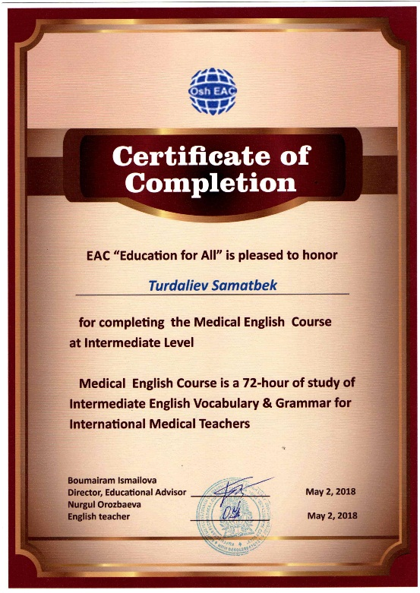
2017-2018

Slide 4
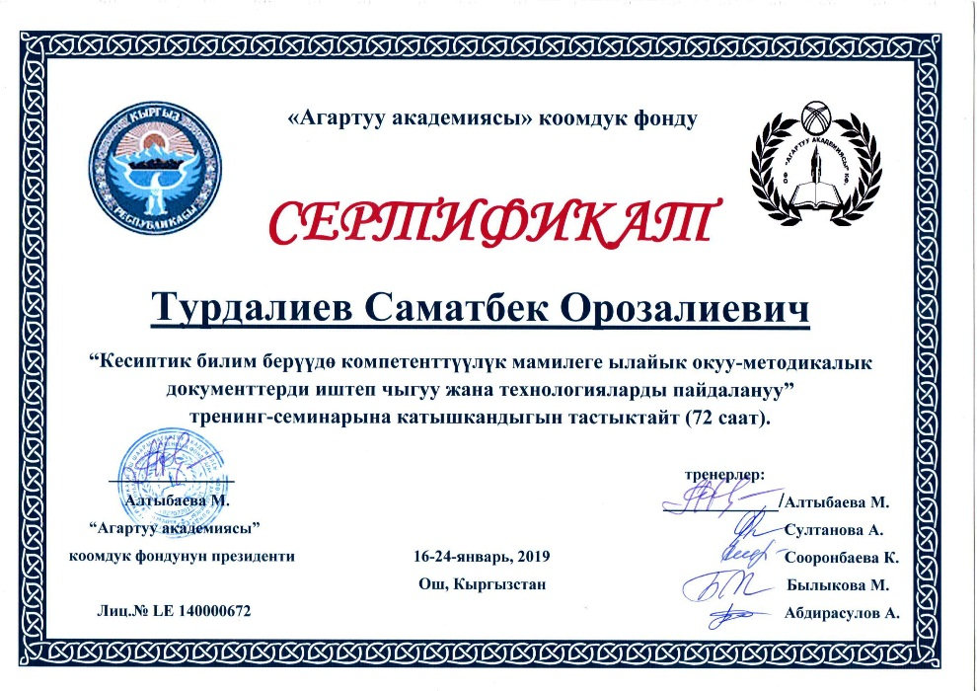
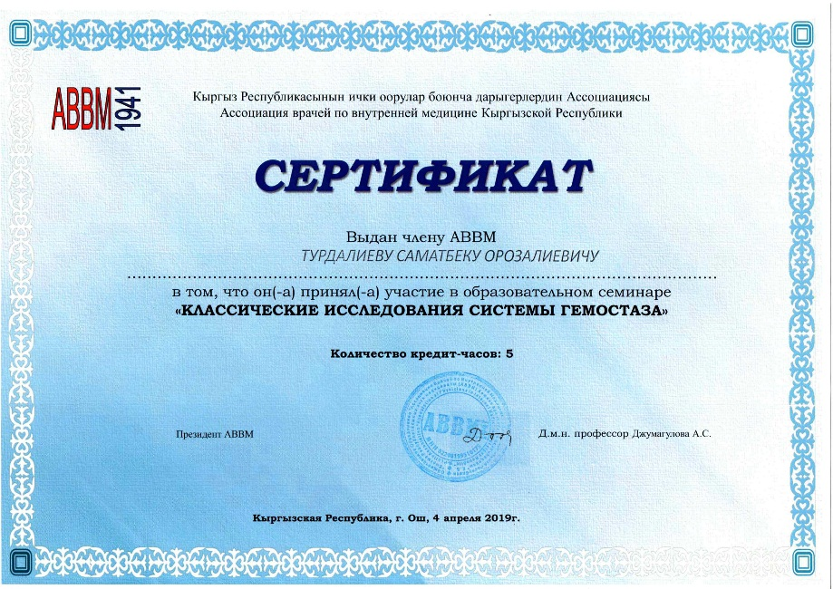
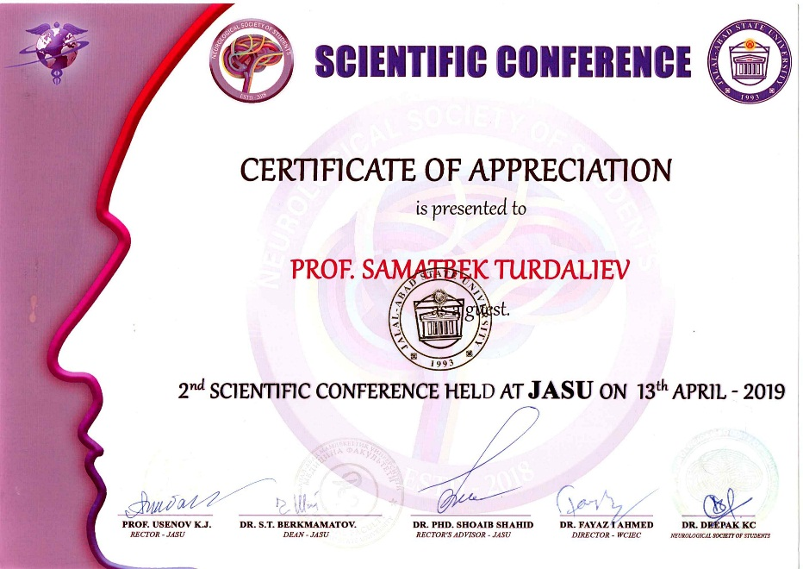
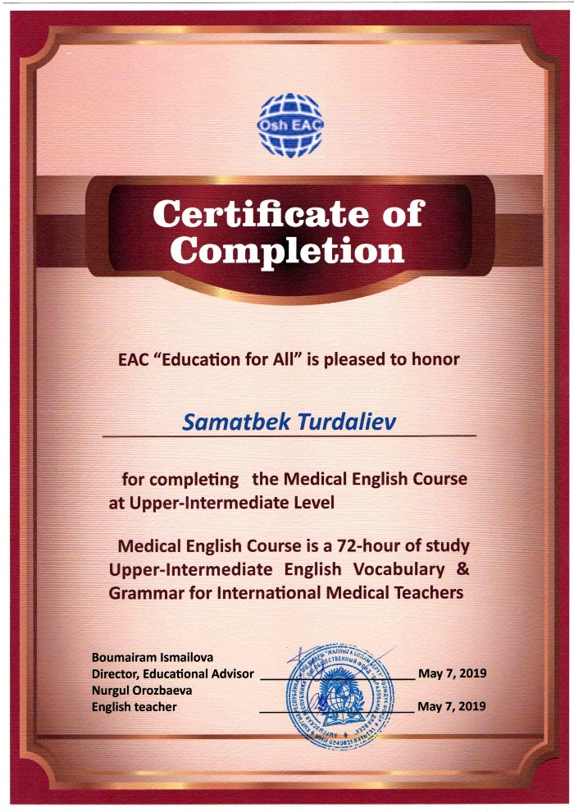
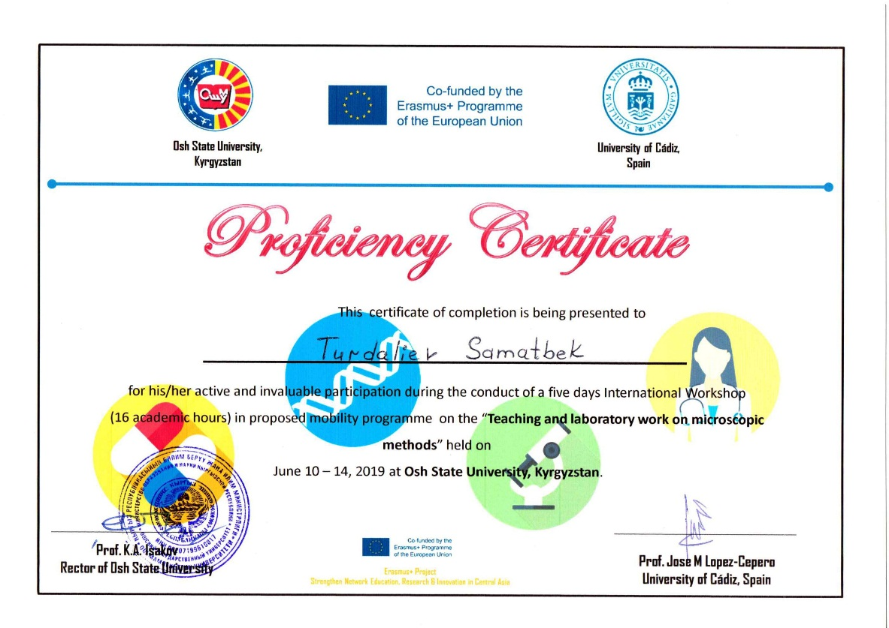
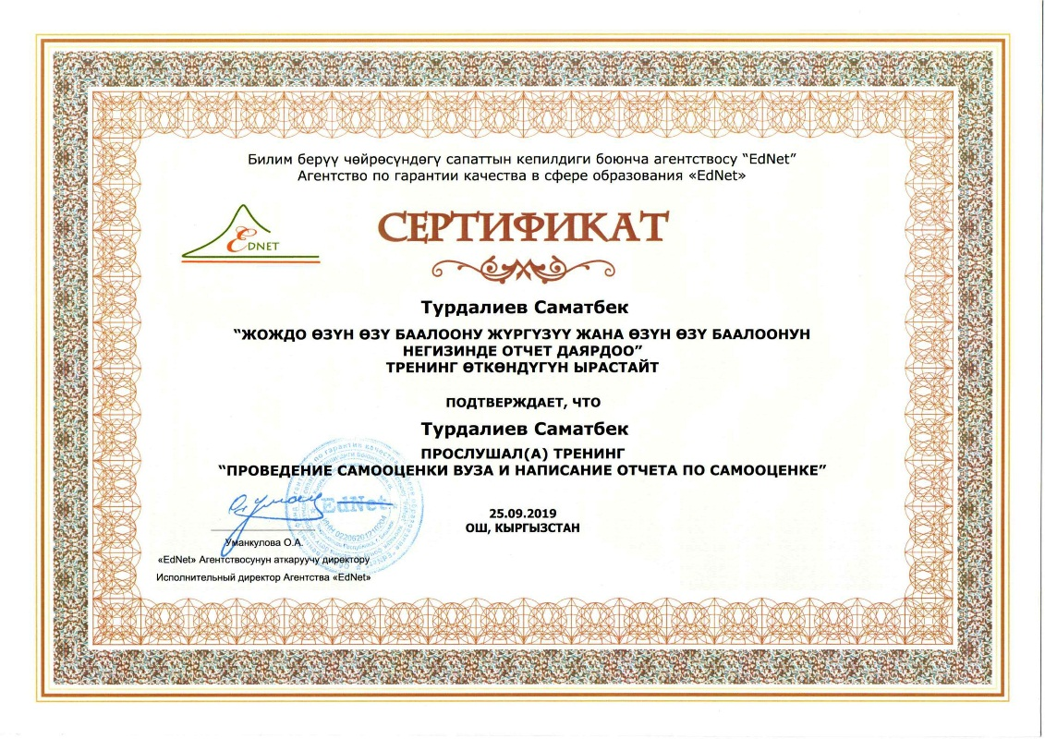
2019-2020

Slide 5
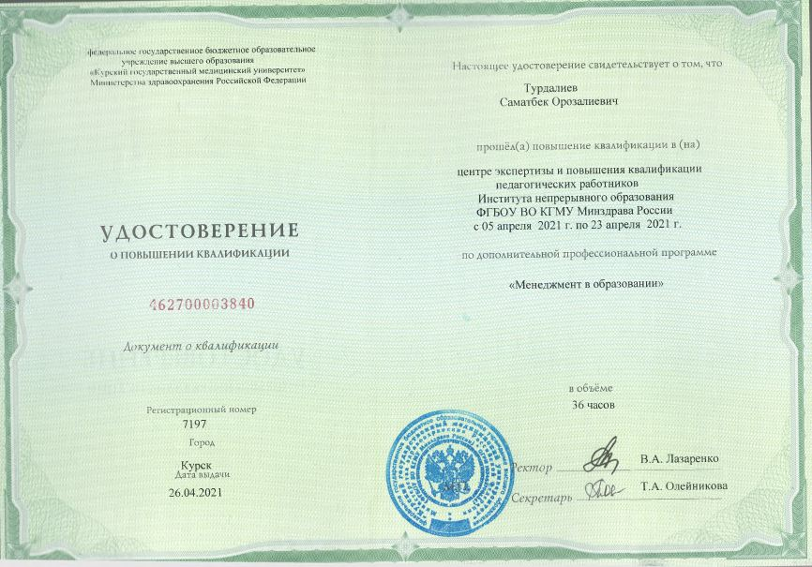
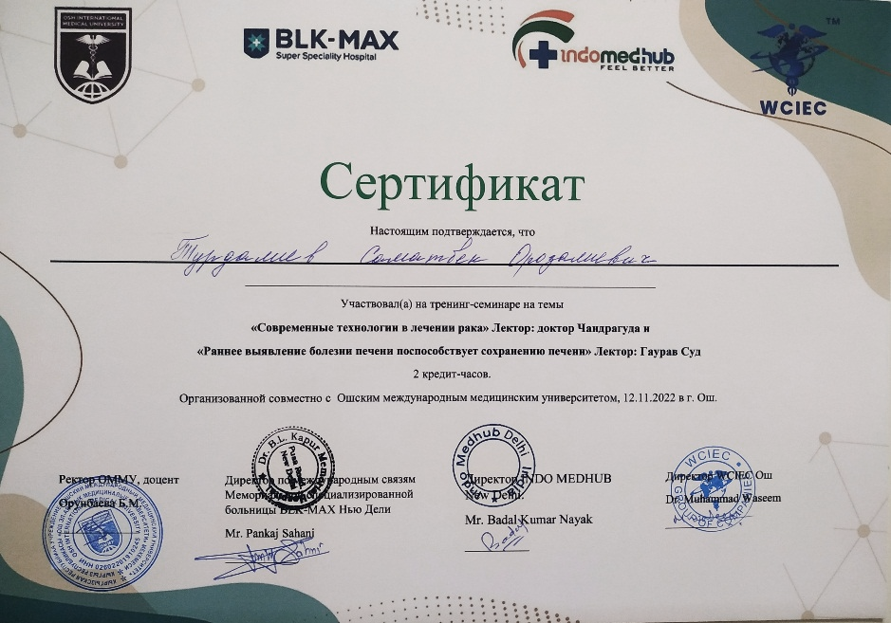
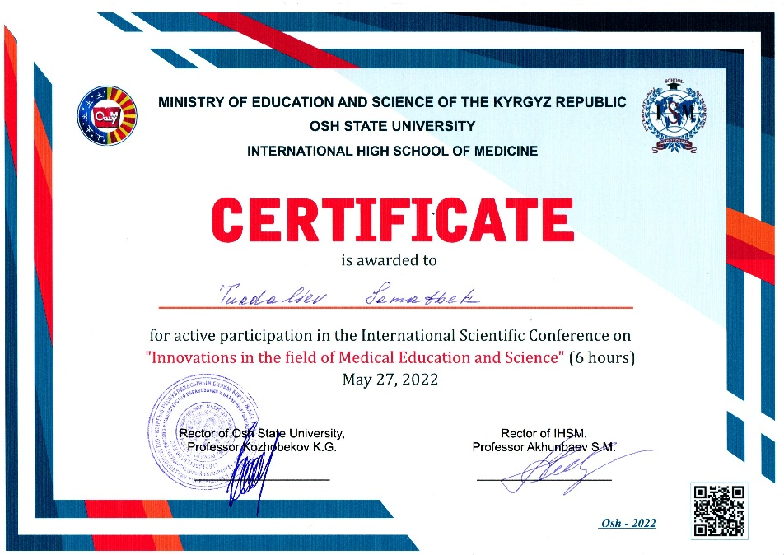
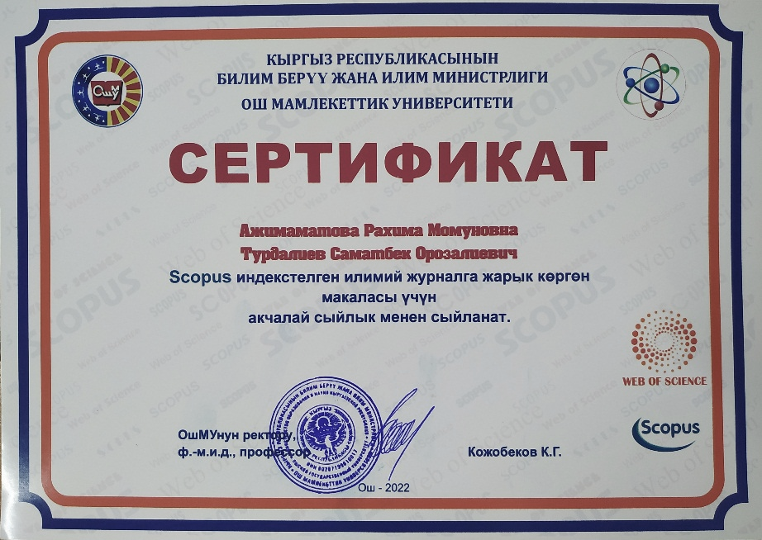
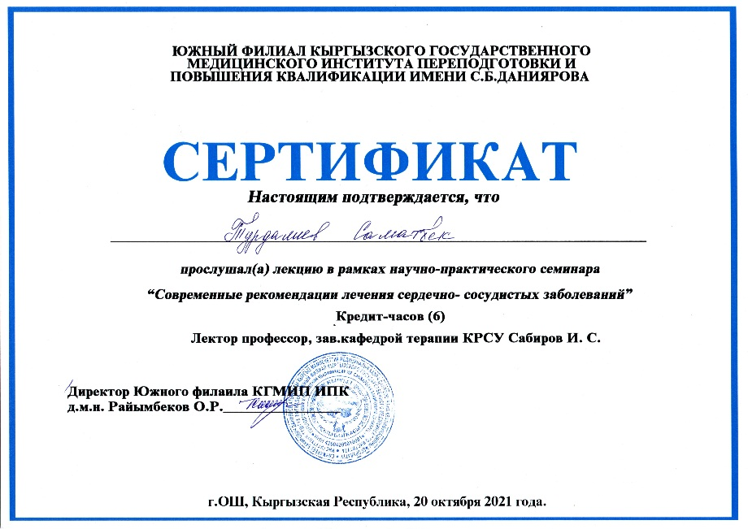
2021-2022

Slide 6
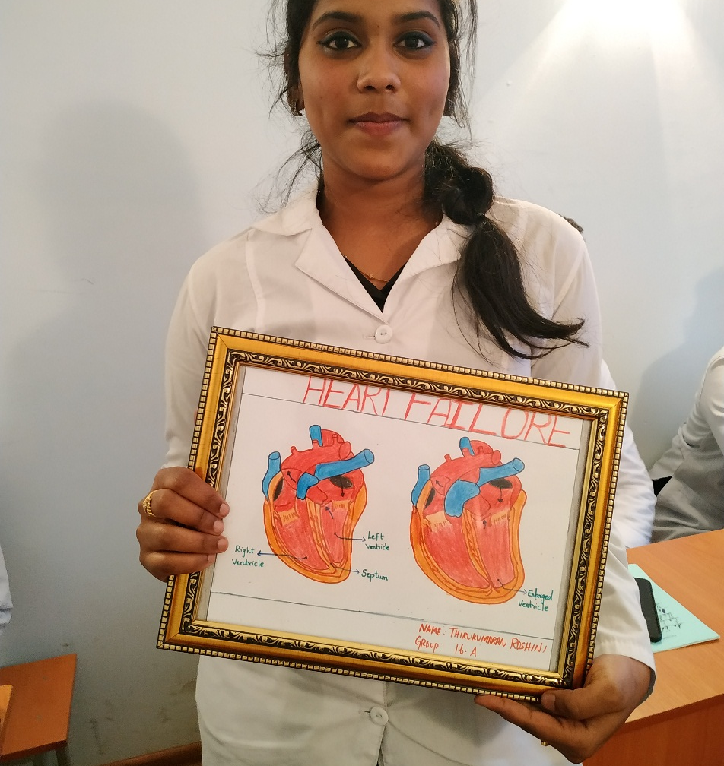
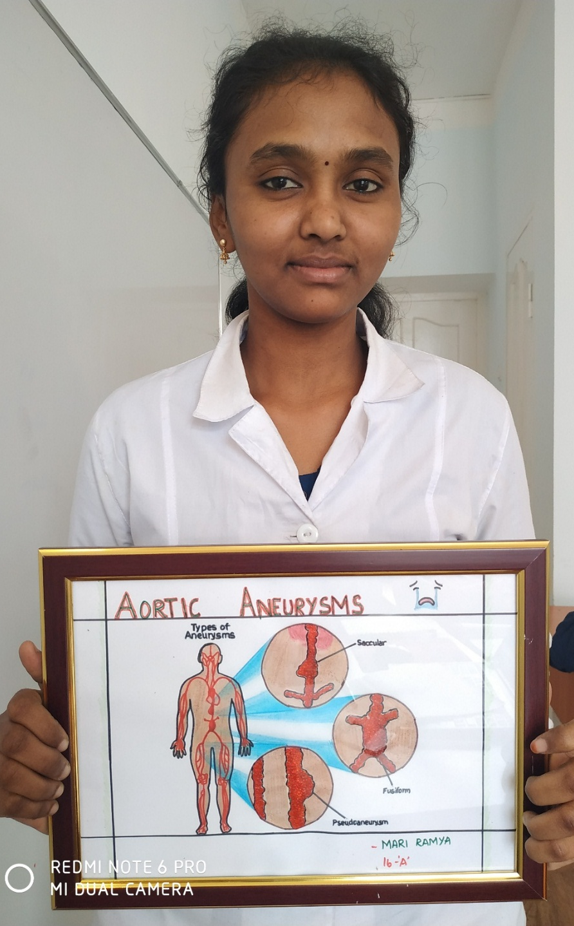
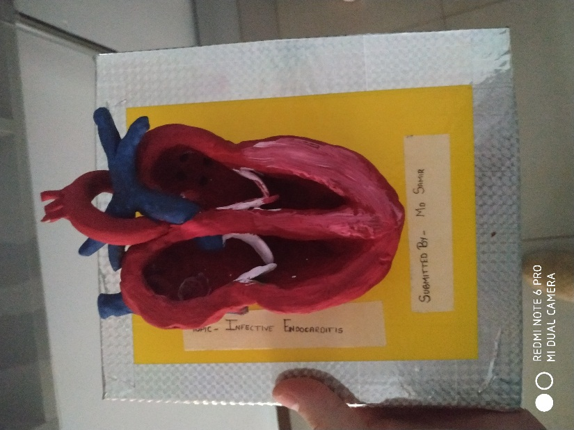
Achievements of my students

Slide 7
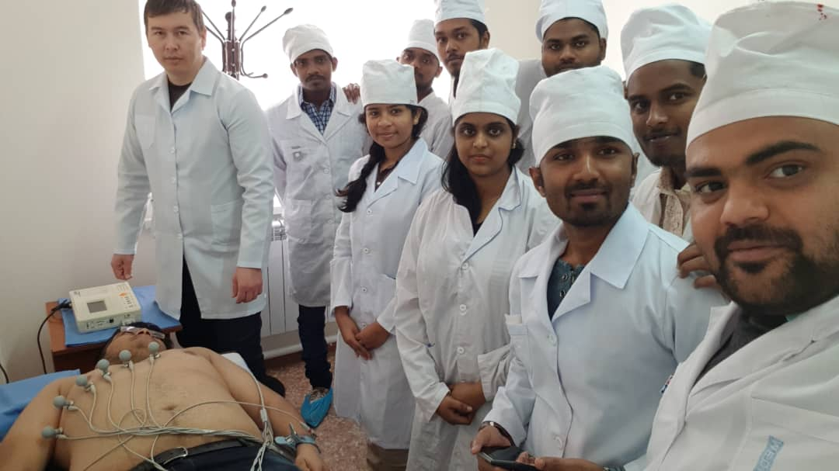
During the practical classes, I focus on developing practical skills of students.

Slide 8
Research work
My research focuses on risk factors for chronic non-communicable diseases and longevity issues. You can find out more at: https://scholar.google.ru/schhp?hl=ru
https://www.actabiomedica.ru/jour/article/view/2730
https://www.springer.com/journal/13329

Slide 9
Contacts:
+996773671690;
+996773671690;
samatbekturdaliev@gmail.com.

