Slide 1
Using Modern Adult Learning Theory to Build Hard Skills and Soft Skills in Medical Students

Slide 2
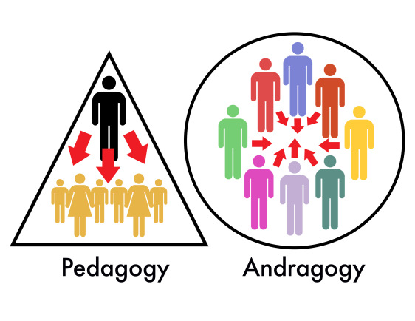
The modern principles of androgogy, is the personal fulfillment of a person throughout his life.
As a rule, most people unfold gradually, accumulating knowledge, experience, skills and abilities throughout their lives.
Consequently, androgogy contributes to the full disclosure of the personality and the realization of one's latent abilities.

Slide 3
Hard skills are professional skills related to the technical side of the functions that students learn in higher education institutions

Slide 4
Soft skills are supraprofessional skills that help to solve life tasks and work with other people

Slide 6
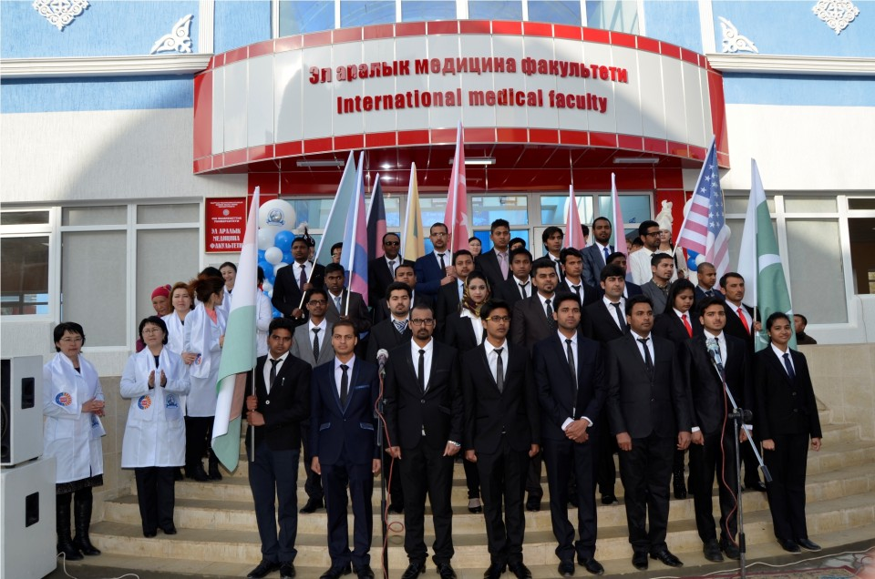
Aim of the research
Analysis of the Effectiveness of Using Modern Adult Learning Theory in the Development
of Soft and Hard Skills in Medical Students

Slide 7
Tasks of the research
To analyze the use of modern principles of andragogy in the educational process.
To conduct a correlation analysis of new andragogy methods for the formation of soft and hard skills
To implement andragogy into the educational process for medical students

Slide 8
Materials and methods of research
Main group (N30) Eng-8-18 and control group(N30) Eng-5-18
Main group
Androgogy
3 groups (5students)
Control group
Traditional methods
1 group (15 students)
1. Case study
2. Briefing
3. Lab work
Questions/answers
Explanation of lab work

Slide 9
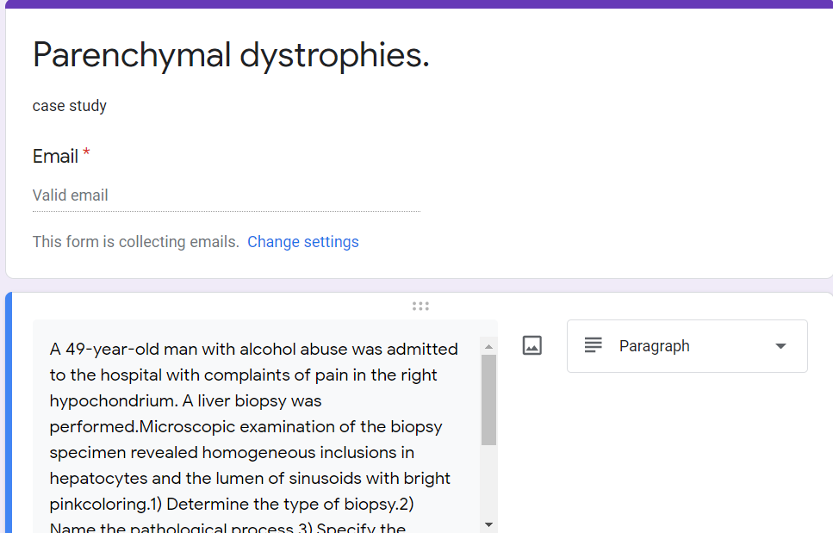
Materials and methods
MCQ on topics Questionare

Slide 10
Results of the research and their discussion
Main group – Androgogy
Increased the effectiveness of gaining knowledge
Increased the formation of Soft skills such as :
Leadership skills
Communication skills
Team building skills et.
Boosting of Hard skills due to practical training
Using microscopes
Micro preparation glass staining

Slide 12
Results of the research and their discussion
Control group – traditional classes
Learning capacity is dramatically lower than in main group
Inactive and disinterested students

Slide 13
Conclusion The use of modern teaching methods as andragogy for medical students has a beneficial effect as it:
Promotes soft skills like communication, leadership, and teamwork
Contributes to the students hard skills such as microscoping
Increases learning capability

