Slide 1
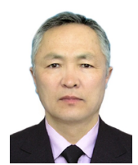
Kurbanaliev Abdikerim Yrysbaevich
Associate professor, doctor of physical and mathematical science, department «Department of Natural sciences» of OIMU

Slide 2
Personal information
→ Born in 1961, November 13
→ Doctor of Physical and Mathematical Sciences since 2014. The topic of the thesis: “Mathematical modeling of internal and two-phase turbulent flows based on the method of control volumes”, which was defended on 2014. https://vak.kg/avtoreferaty/page/142/
→Candidate of Physical and Mathematical Sciences since 1992. The topic of the thesis: “Mathematical modeling of turbulent reacting flows, taking into account the formation of environmentally harmful impurities”, Novosibirsk 1992. https://search.rsl.ru/ru/record/01007940474
→ Teaching experience at the university since September 1984 till now. →From June 26, 2018 – associate professor and head of department «Depatment of Natural Sciences and Mathematics» in IMF of OshSU.
June 2018- present
Head of the Department of Natural Sciences and Mathematics of the International Medical Faculty of Osh State University

Slide 3
Selected Papers
https://www.scopus.com/authid/detail.uri?authorId=55973158400
Conference Paper
Mathematical Modeling and Visualization of Large-Scale Flooding in the Flood Plain of Naryn River Using OpenFOAM
Kurbanaliev, A.Y., Oichueva, B.R., Alieva, C.M., Bokoev, K.A., Mamaev, S.S.
Lecture Notes in Networks and Systemsthis link is disabled, 2022, 503 LNNS, стр. 357–365
Conference Paper •
Simulation of turbulent flow over the hill
Kurbanaliev, A.Y., Turganbaeva, A.B., Berdibekova, K.T., Bokoev, K.A.
Journal of Physics: Conference Seriesthis link is disabled, 2021, 2094(2), 022045
Citations
Conference Paper
Numerical simulation of nonstationary laminar flow around a circular cylinder
Kurbanaliev, A.Y., Kalmurzaeva, A.T., Kalbekova, M.Zh., Dyikanova, A.T., Amankulova, N.A.
AIP Conference Proceedingsthis link is disabled, 2021, 2402, 070055
Citations
Conference Paper
Critical reviewing of OpenFOAM buoyant cavity tutorial
Kurbanaliev, A.Y., Kalbekova, M.Zh., Kalmurzaeva, A.T., Dyikanova, A.T.
AIP Conference Proceedingsthis link is disabled, 2021, 2402, 020009
Citations
Conference Paper
Using openFoam multiphase solver interfoam for large scale modeling
Kurbanaliev, A.I., Maksutov, A.R., Obodoeva, G.S., Oichueva, R.
Lecture Notes in Engineering and Computer Science, 2019, 2019-October, стр. 366–370
Citations
Article
Verification of the open package OpenFOAM on dam break problems
Zhainakov, A.Z., Kurbanaliev, A.Y.
Thermophysics and Aeromechanicsthis link is disabled, 2013, 20(4), стр. 451–461

Slide 4
Education
September 1987- April 1992
Internship, Postgraduate studies at the Institute of Theoretical and Applied Mechanics and Institute of Thermal Physics of the Siberian Branch of the Russian Academy of Sciences of the USSR.
September 1979- June 1984
Undergraduate studies at the Novosibirsk State University, USSR

Slide 5
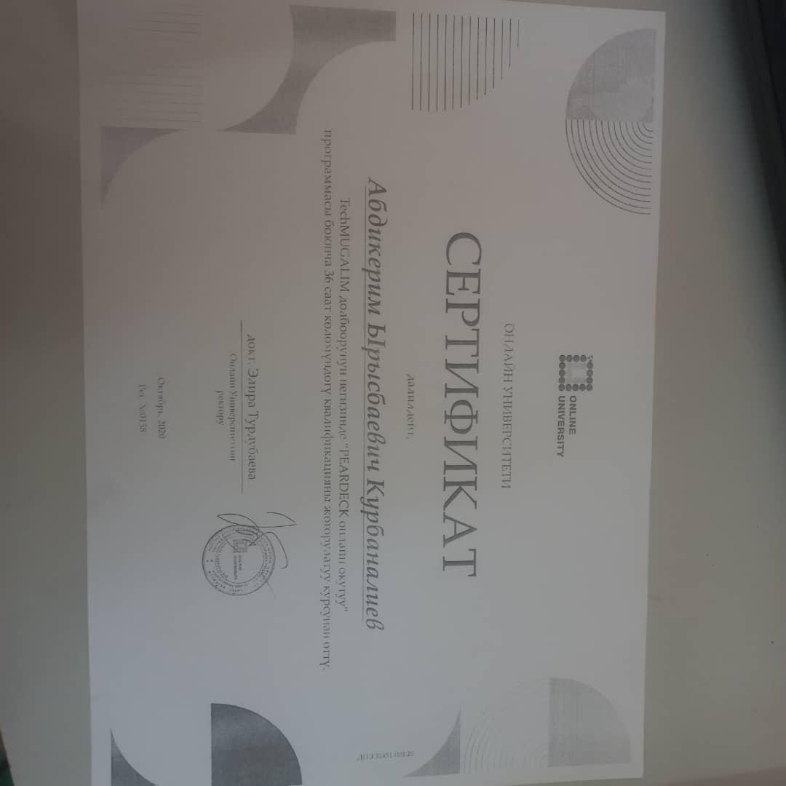
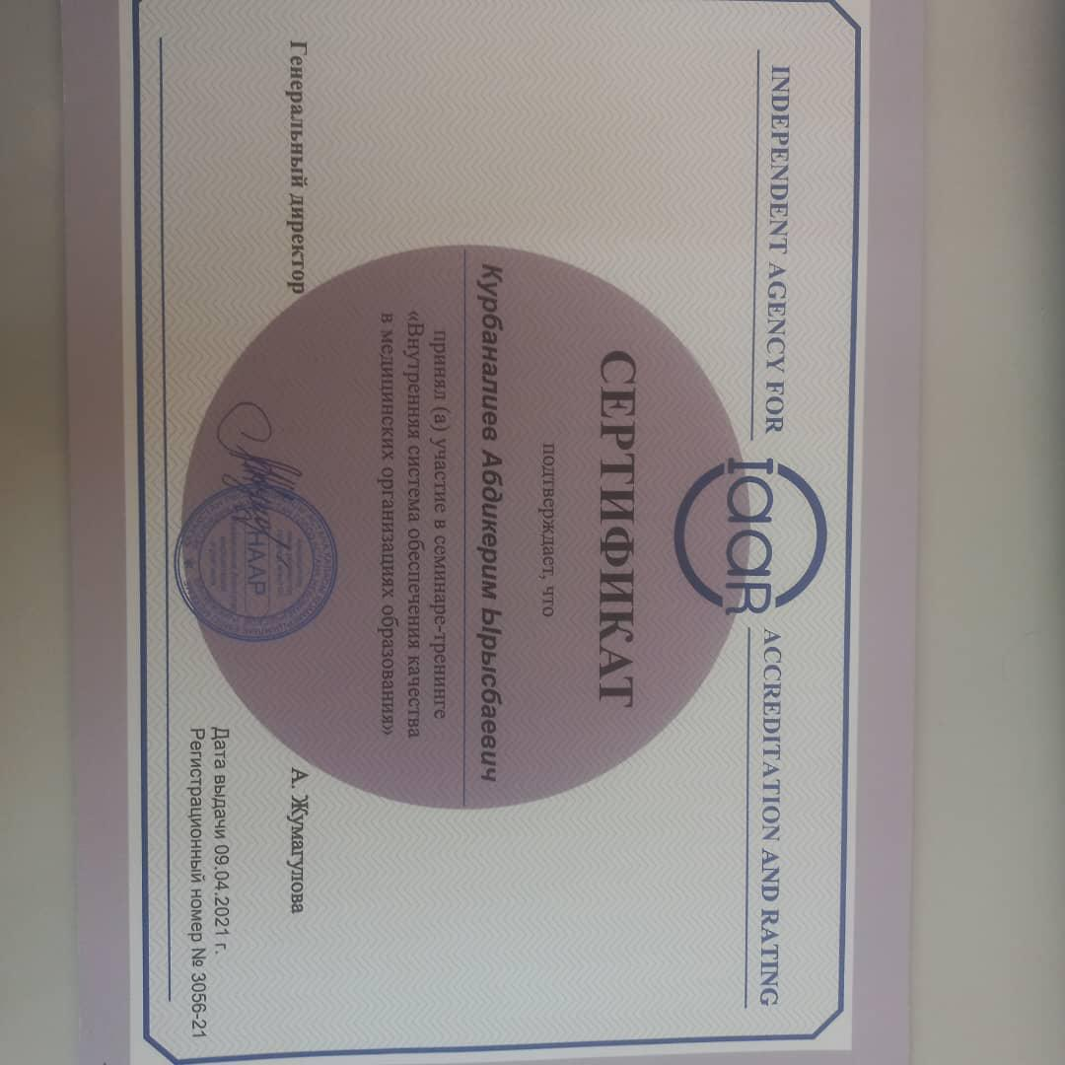
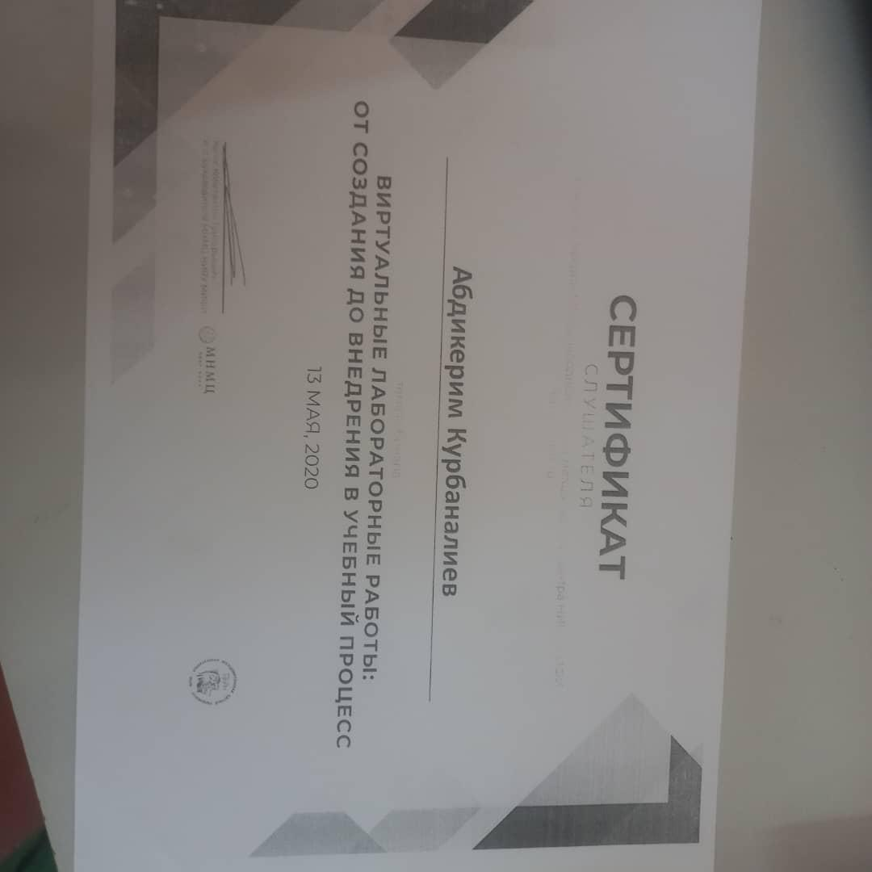
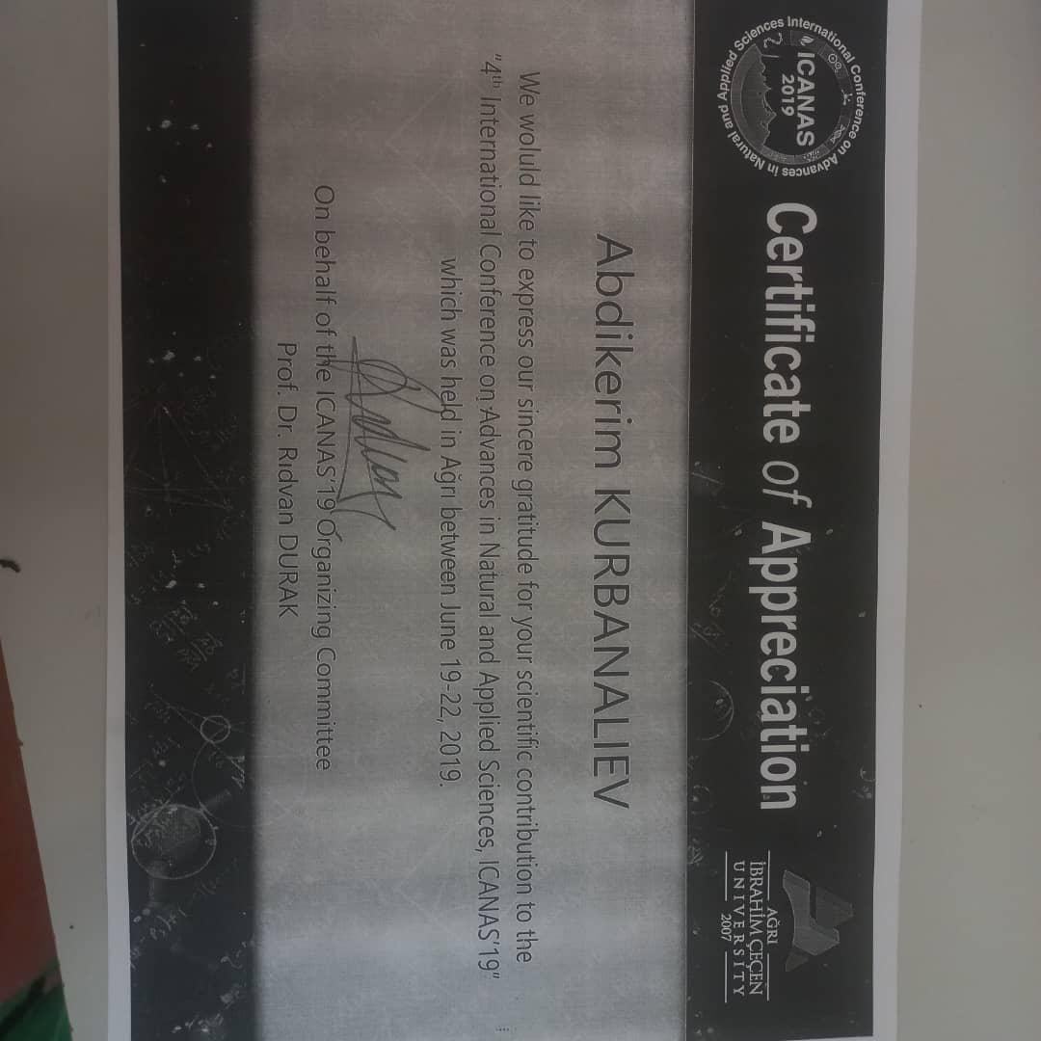
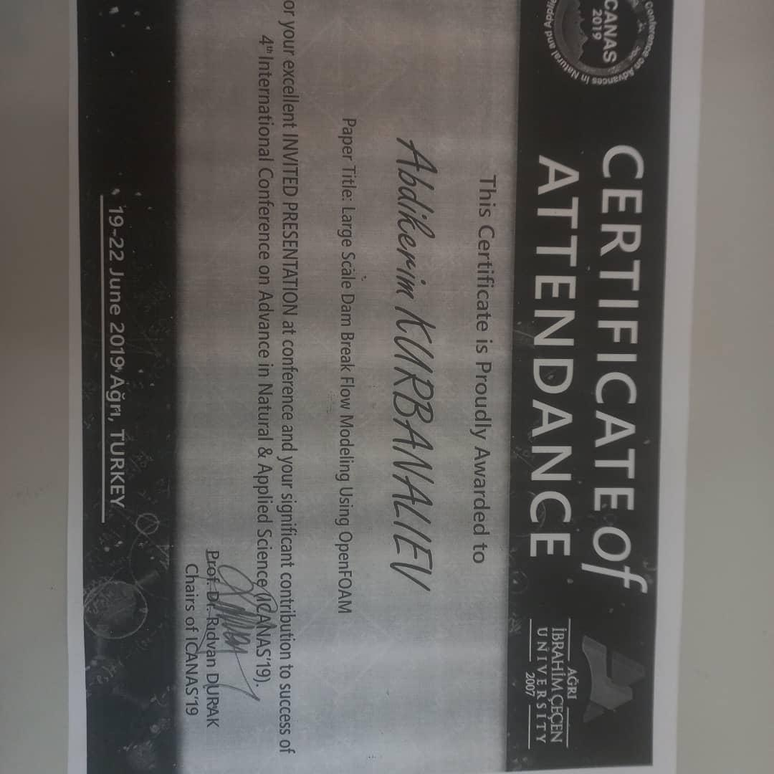
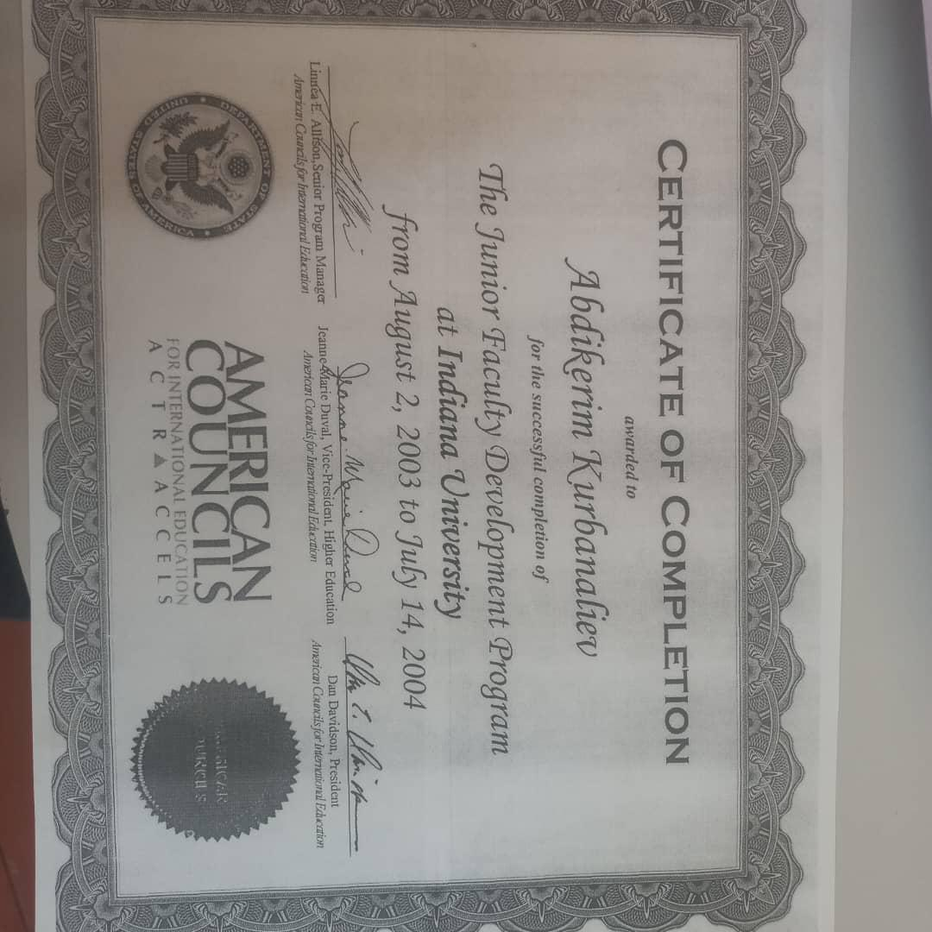
Advanced training
The user can demonstrate on a projector or computer, or print the presentation and make it film
The user can demonstrate on a projector or computer, or print the presentation and make it film
The user can demonstrate on a projector or computer, or print the presentation and make it film
The user can demonstrate on a projector or computer, or print the presentation and make it film

Slide 6
Work experience
September 1984-September 1998
Lecturer, Senior Lecturer, Osh State University
September 1998-September 2000
Head of the Department of Computer Science, Kyzylkiy Branch of Osh State University
September 2000-April 2011
Dean of the Faculty, Kyzylkiy Humanitarian Pedagogical Institute of Batken State University
April 2011-October 2011
Vice-Rector for Academic Affairs, Batken State University
October 2011-February 2016
Deputy Director for Academic and Scientific Work, KSPI of Batken State University
February 2016 - June 2018
Associate Professor, and about Professor of the Department of Natural Sciences and Mathematics of the International Medical Faculty of Osh State University
June 2018- present
Head of the Department of Natural Sciences and Mathematics of the International Medical Faculty of Osh State University

Slide 7
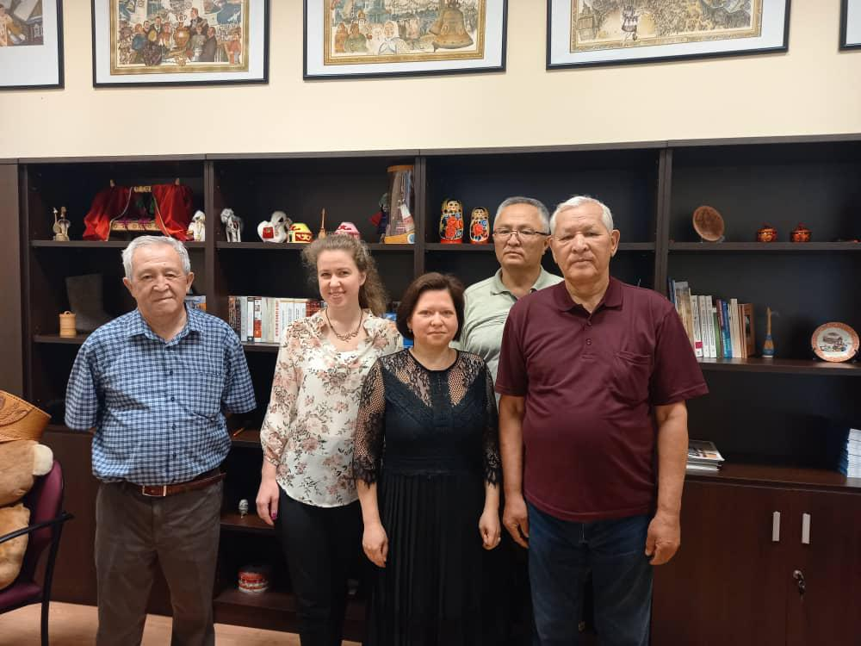
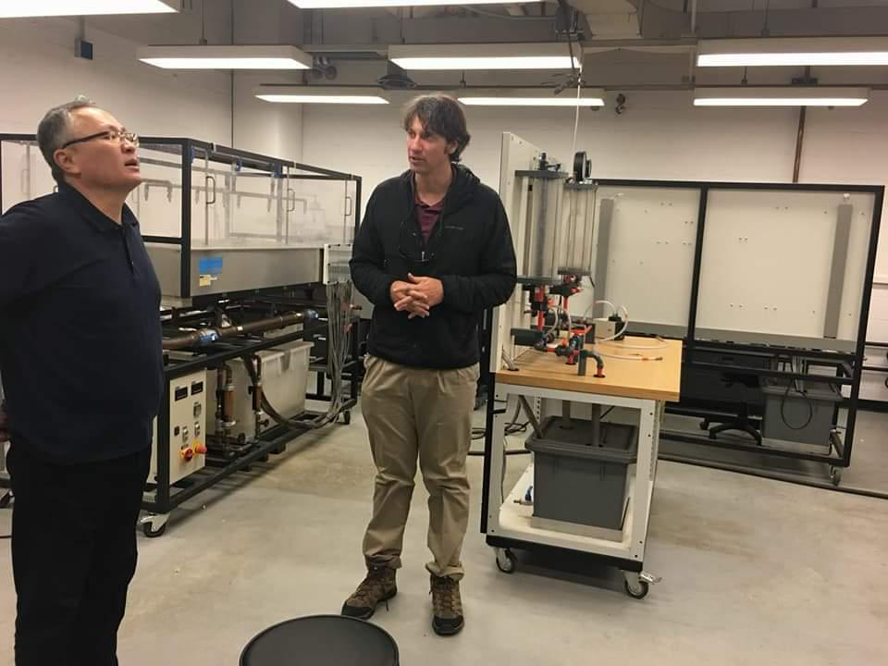
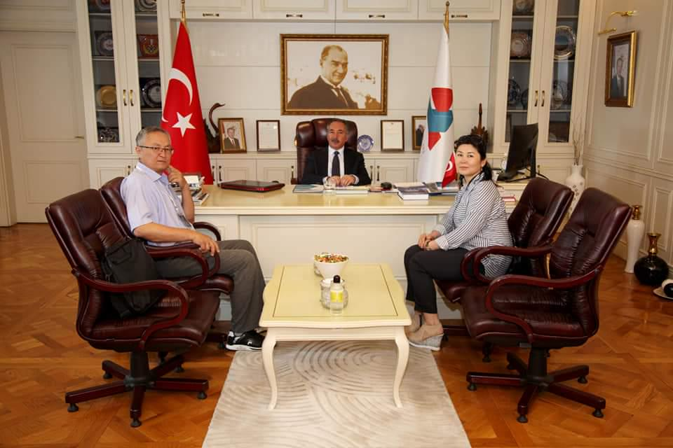
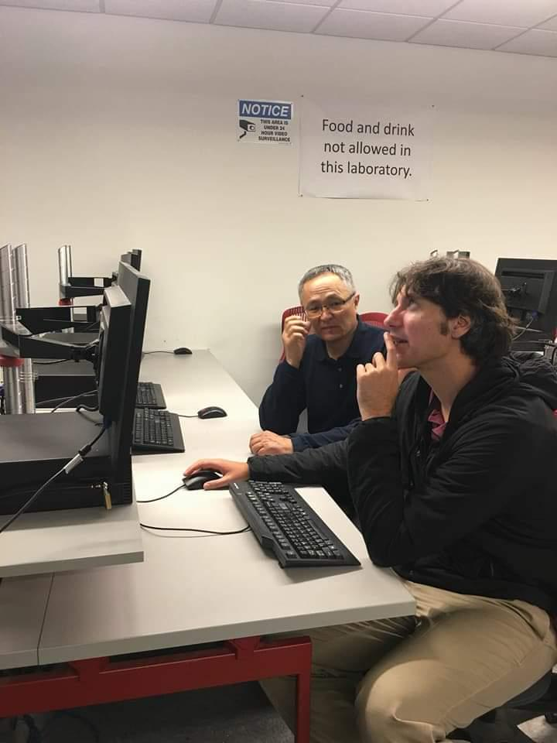
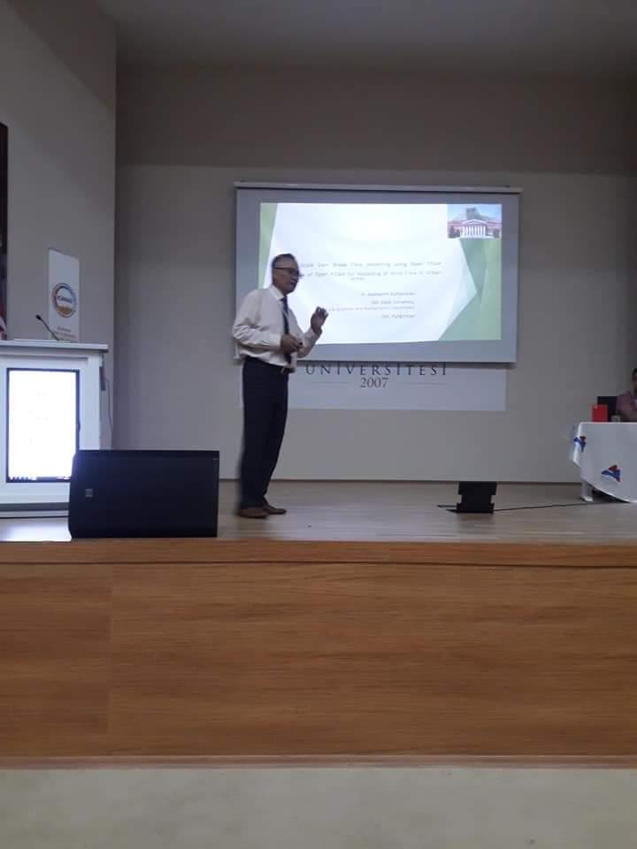
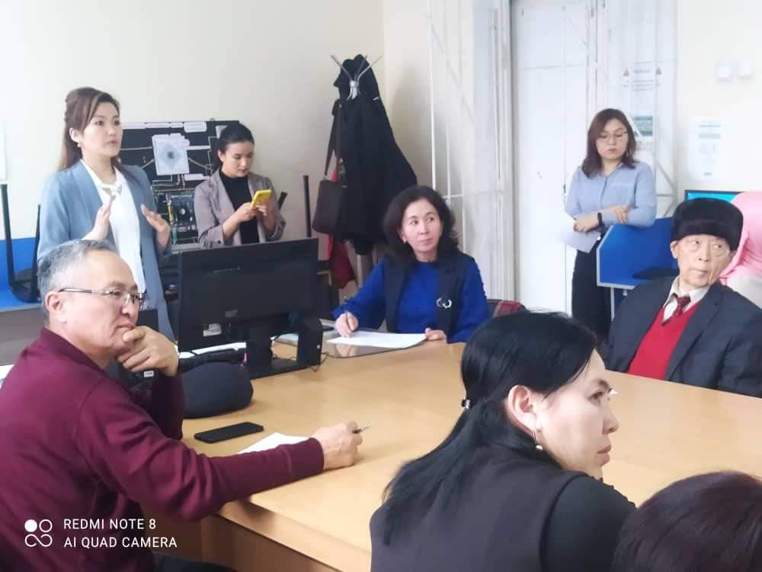
International internship
Cadiz University, Spain, 2022
University of Chicago, Chicago, 2018
Agry University, Agry, Turkie, 2018
Oxford University, UK, 2008
Indiana University, Bloomington, USA, 2003, 2010
Title text addition
The user can demonstrate on a projector or computer, or print the presentation and make it film
Title text addition
Title text addition
The user can demonstrate on a projector or computer, or print the presentation and make it film
The user can demonstrate on a projector or computer, or print the presentation and make it film

Slide 8
Contact information
Phone & WhatsApp number: +996 779 707 112
E-mail: abdikerimkurbanaliev@oshsu.kg
1
03
05
0
04
06

