Slide 1
Muratov Bekzhan Abdizhalilovich

Slide 2
PERSONAL INFORMATION
● Born in 1th of may 1995 in Osh city.
● In 2018, graduated from the Kyrgyz State Medical Academy and entered a clinical residency in Osh, on the basis of the KGMiPK.
● Working as Urologist in Osh city hospital-. 2018-2020
● Since 2022, I have been working in Osh International Medical University” in Department of Natural Sciences.

Slide 3
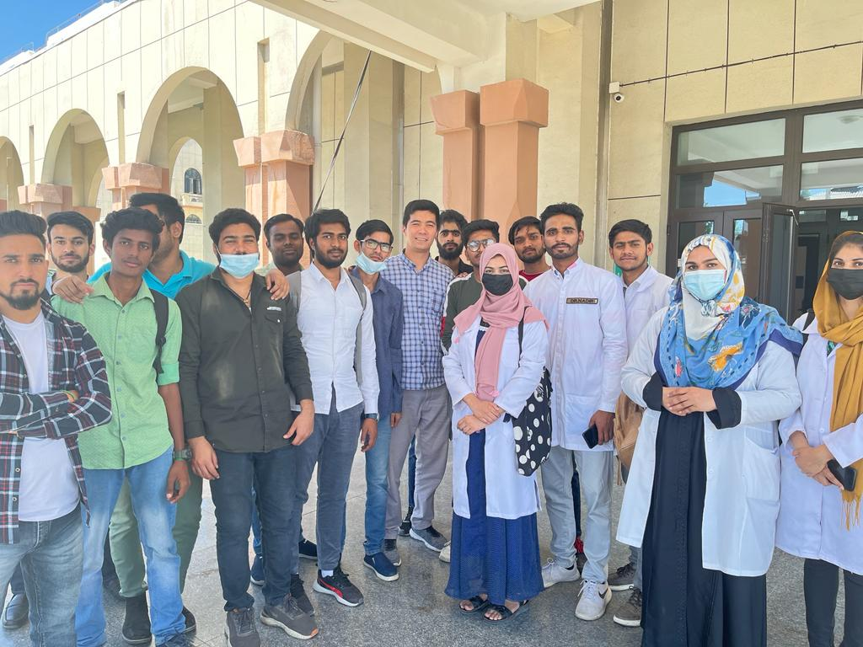
Working with students
I work as Head of Practice at Osh International Medical University

Slide 4
Key qualifications
Refresher training in pedagogy and psychology.
Advanced training in formative summative assessment in university.
Attended a seminar on "Modern technology in the treatment of cancer"

Slide 5
Certificates

Slide 6
Contacts
Occupation: Osh International Medical University.
Department of natural sience.
E-mail: Muratovbekjan95@gmail.com
Tel: +996554199098; +996508199098.

