Slide 1

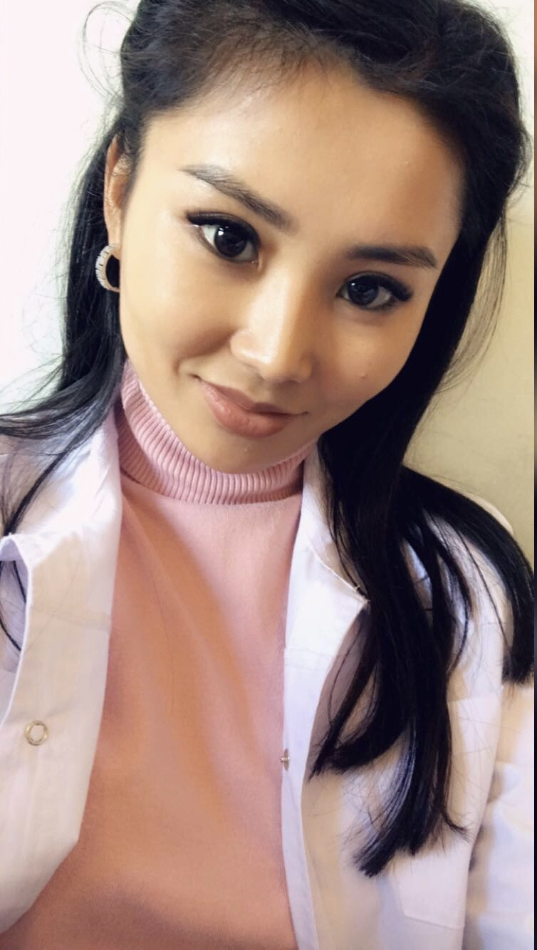
Nurlanova Nurperi Nurlanovna

Slide 2
PERSONAL INFORMATION
● Born in 16 of September of 1996 in Osh city.
● In 2020, graduated from the Kyrgyz State Medical Academy and entered a clinical residency in Osh, on the basis of the KGMiPK.
● Working as teacher of microbiology in ADAM University- 2020-2021
● Since 2022, I have been working in Osh International Medical University” in Department of Natural Sciences.

Slide 3
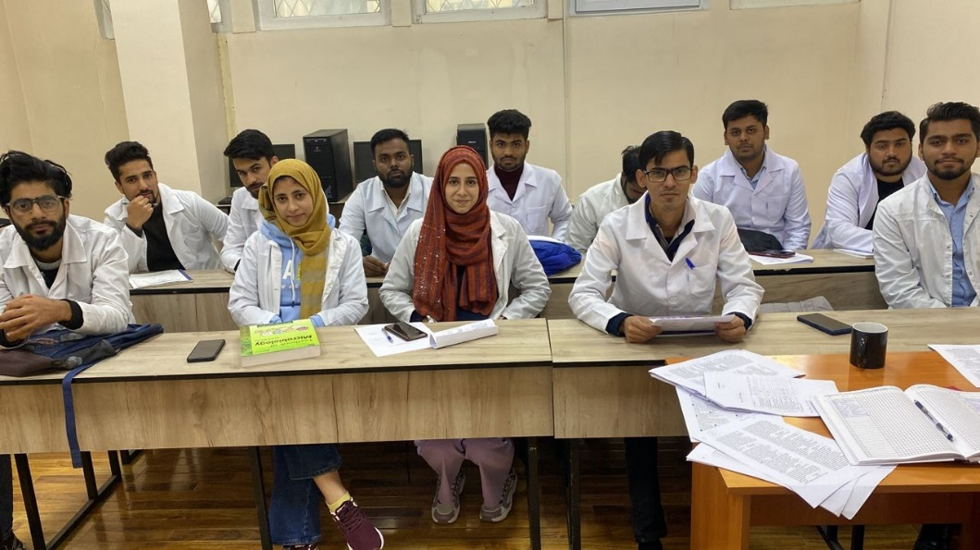
Working with students

Slide 4
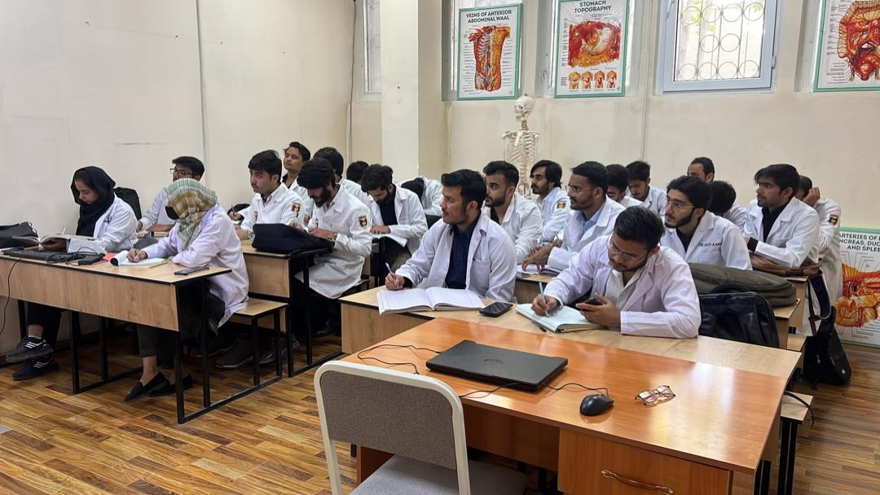
Working with students

Slide 5
Key qualifications
Refresher training in pedagogy and psychology.
Advanced training in formative summative assessment in university.
Attended a seminar on "Modern technology in the treatment of cancer"

Slide 6
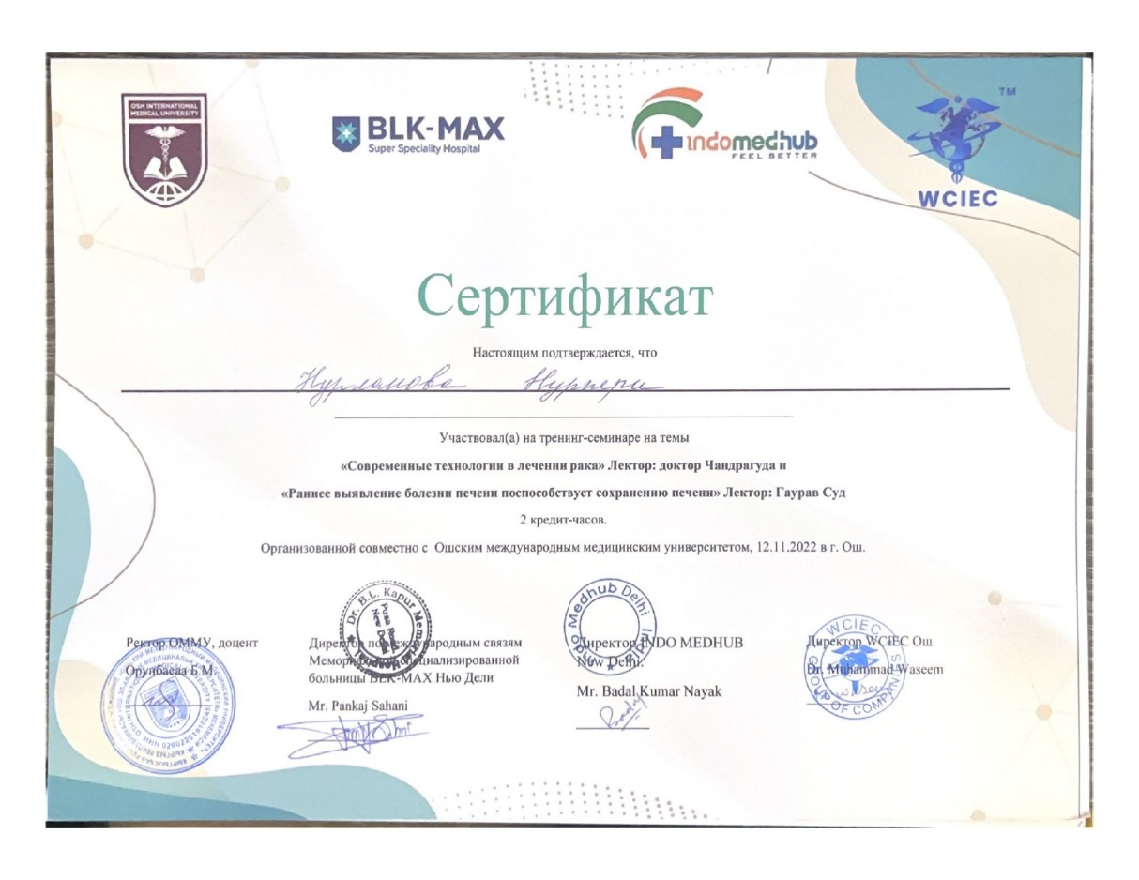
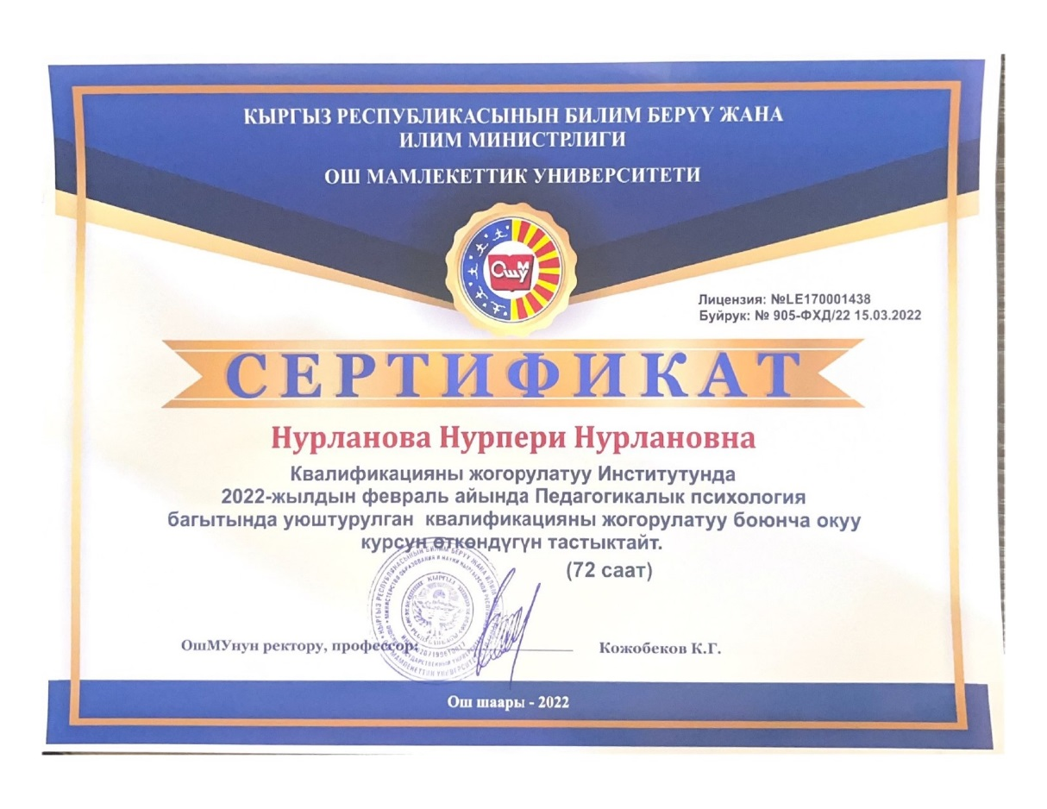
Certificates

Slide 7
Contacts
Occupation: Osh International Medical University.
Department of natural sience.
E-mail: Nurlanovanurperi9@gmail.com
Tel: +996558900976.

