Slide 1
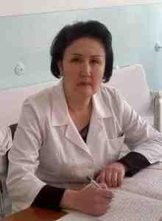
Osh International Medical University «Department NATURAL SCIENCES»
Portfolio of the teacher of the discipline “Internal Diseases” Attokurova Gulmira Nyshanbayevna
candidate of medical Sciences

Slide 2
Personal Details
Full name of the teacher Attokurova Gulmira Nyshanbayevna
Date of birth 02.11.1975
Work station Osh State University, International Medical Faculty
Position Teacher at IMF
Teacher discipline “Internal diseases“
Teaching experience 17 year.
Contact phone +996 559 596 040
E-mail: gulmira_gastro@mail.ru

Slide 3
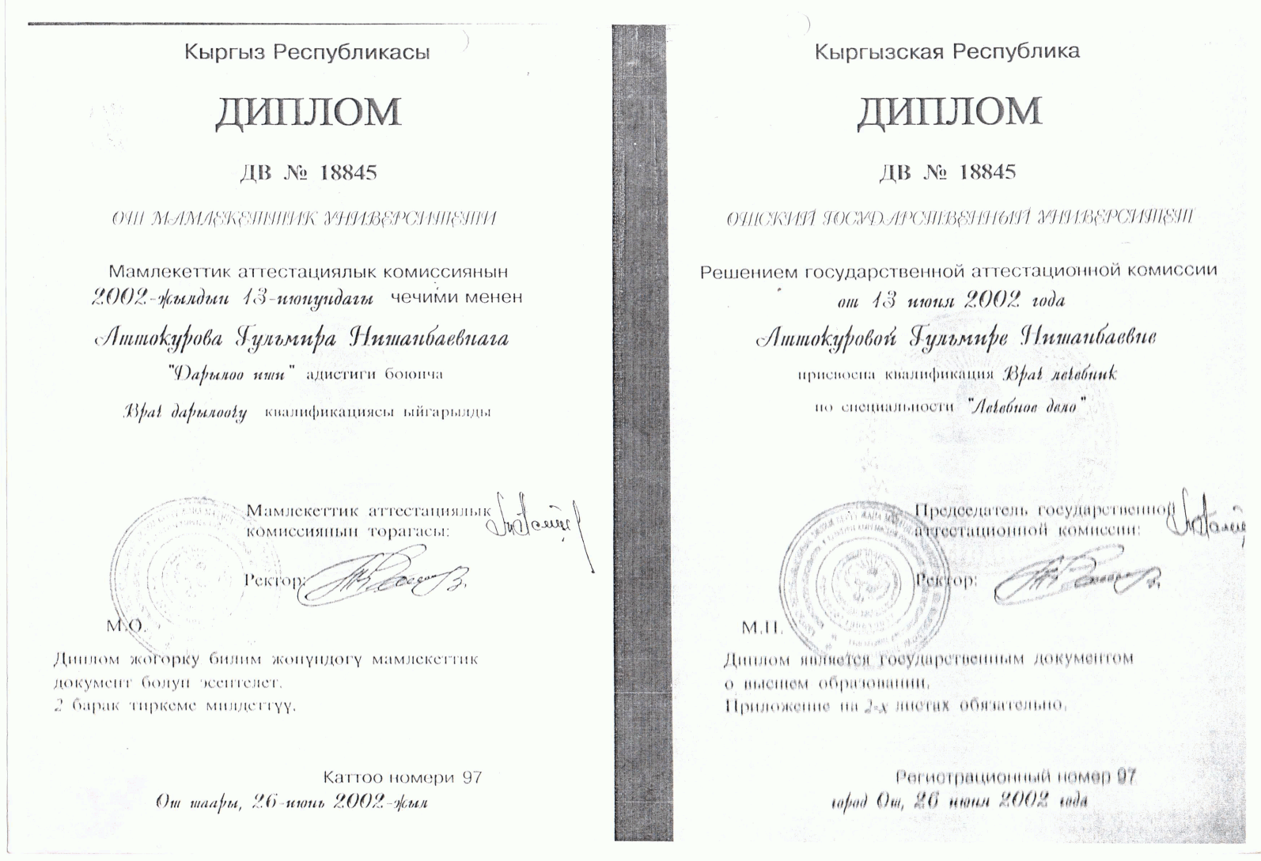

Slide 4
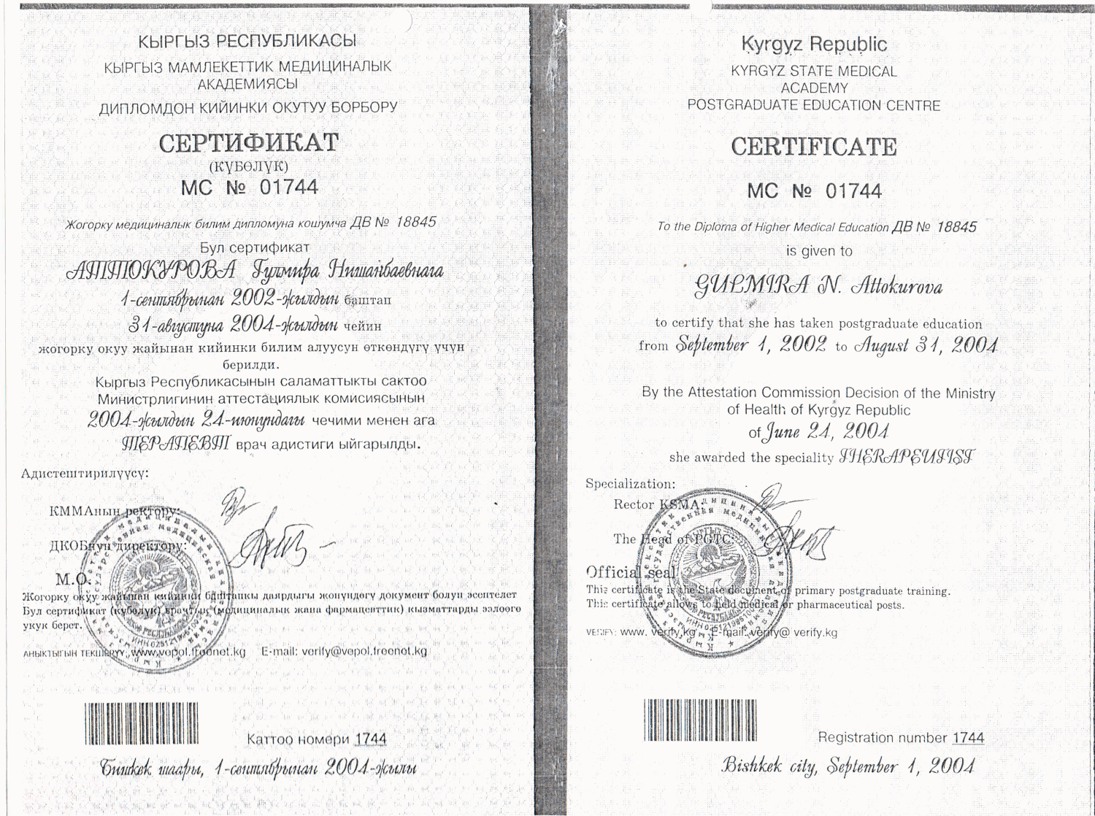

Slide 5
