Slide 1
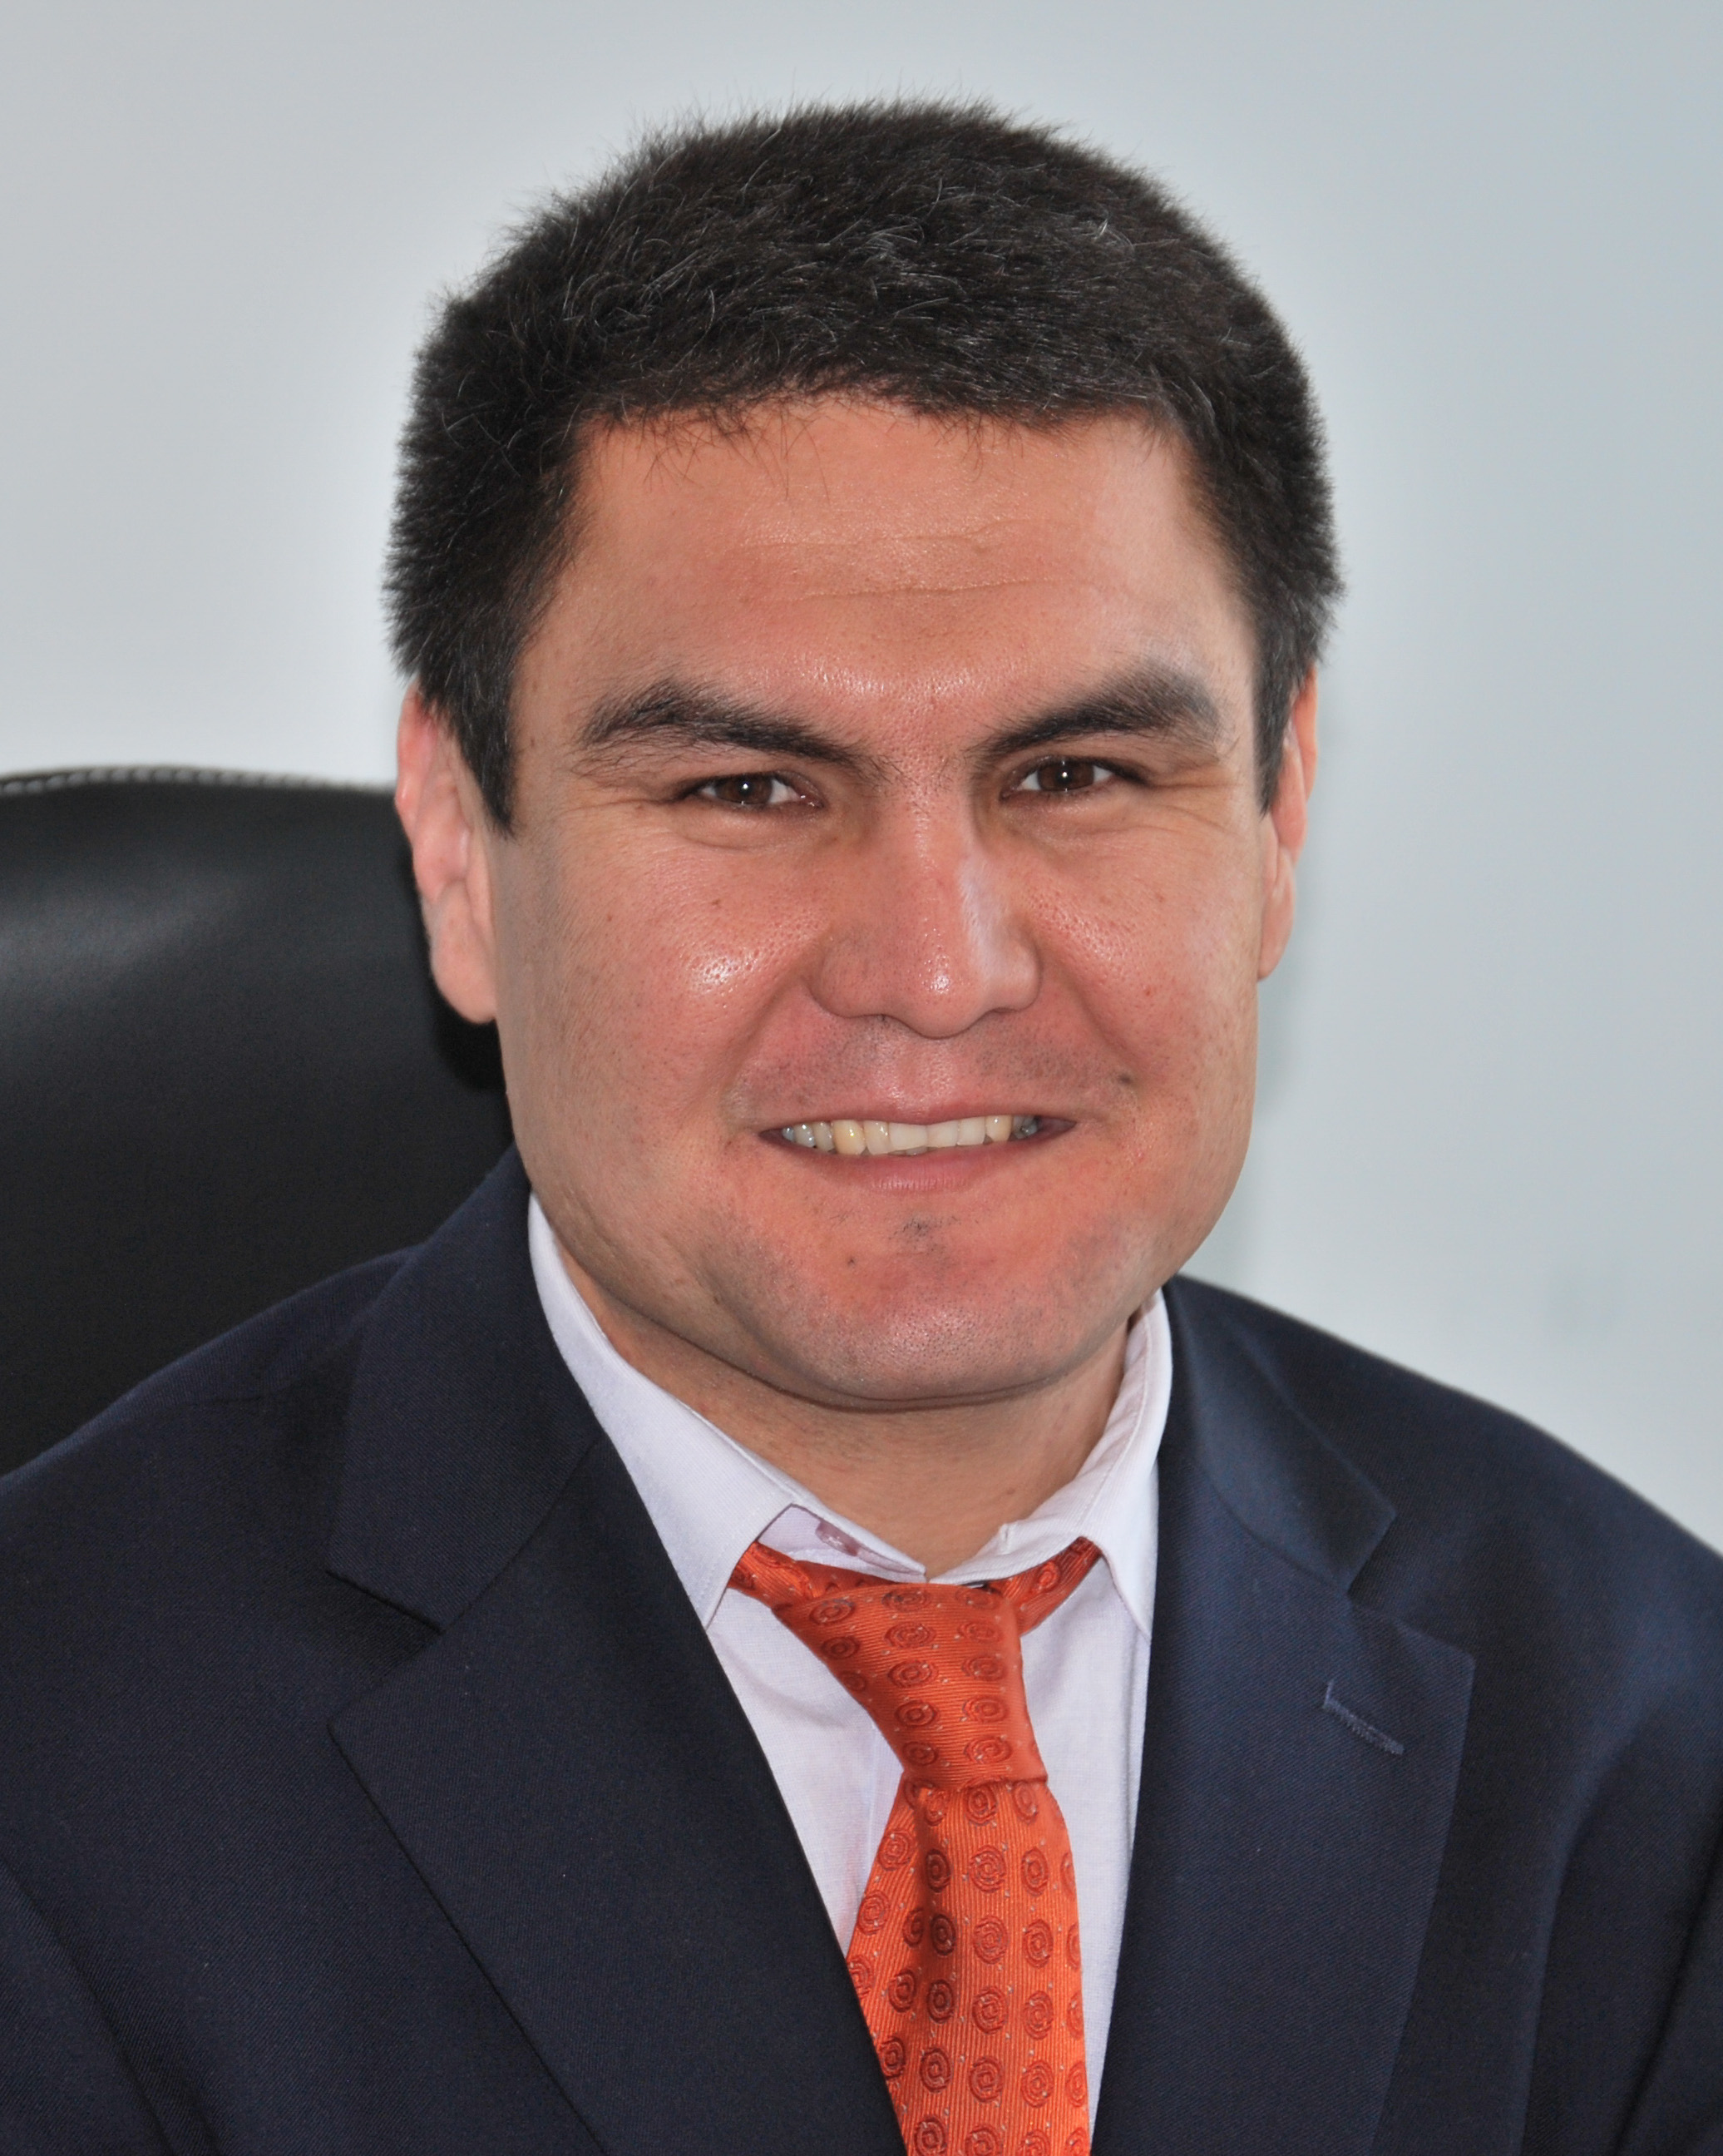
Kalmatov roman kalmatovich

Slide 2
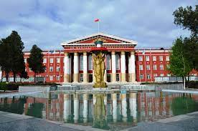
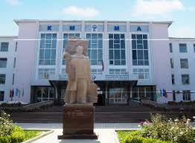
education
2016. Osh State University, Physiotherapist
2008 south branch KSMITandAT, ultrasound doctor
2004. Institute of Western Education (Taylor)English and Business Basics Courses
2005. Kyrgyz State Medical Academy (Certificate of a surgeon)

Slide 3
Work experience (last 5 years)
2021 - Vice-rector for medical work and development of clinical bases of Osh State University
2020 - 2021 Advisor to the Minister of Education and Science of the Kyrgyz Republic
2020 - National Expert on Reforming Higher Education in the Kyrgyz Republic
2020 - Project Manager for Osh State University "Development of PhD doctoral studies and scientific potential of Kyrgyzstan / DERECKA "Erasmus Plus
2018 - 2020 Medical Advisor to the Rector of Osh State University2016 - 2021 Director of UNIPK "University Clinic" Osh State University
2015 - 2016 Osh State University, International Medical Faculty, Dean

Slide 4
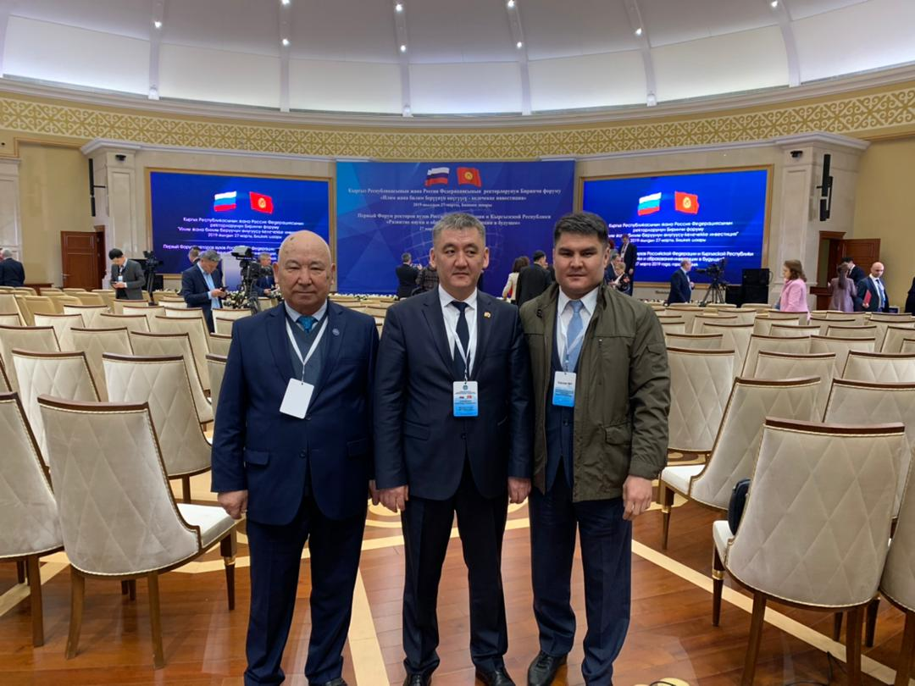
Scientific achievements
2005 Ph.D. thesis defense at the dissertation council at KRSU - candidate of medical sciences
2017 Defense of a doctoral dissertation at the Interdepartmental Dissertation Council D 03.16.533 - Doctor of Medical Sciences
2015 Professor RAE
2018 Professor of Osh State University
2020 Member of the international community of doctors of ultrasound diagnostics in the field Obstetrics and Gynecology, London, England
2020 Corresponding Member of RAE, Moscow.

Slide 5
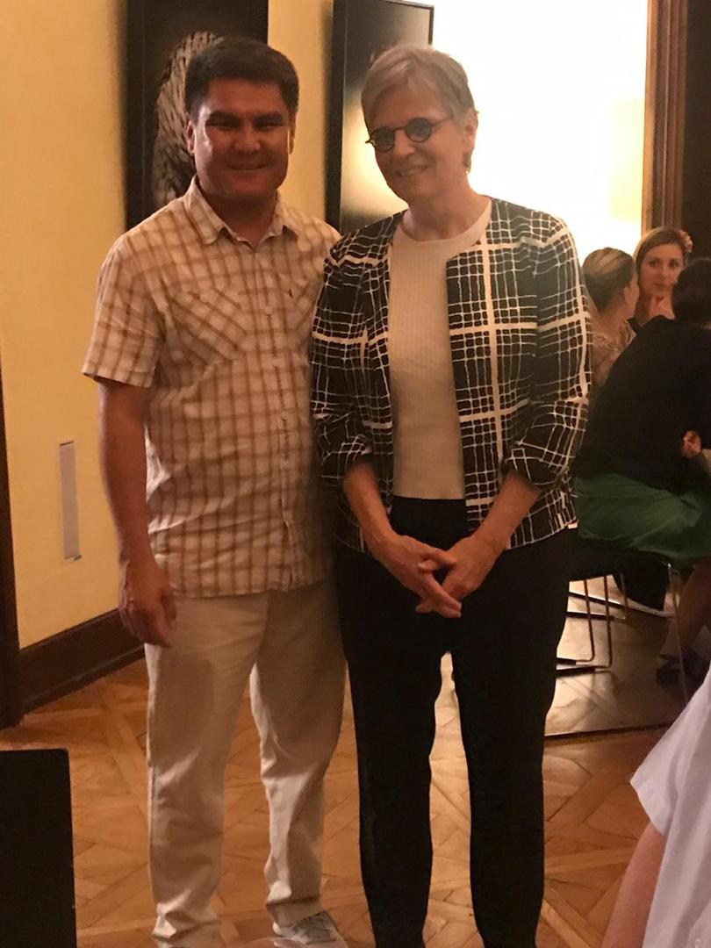
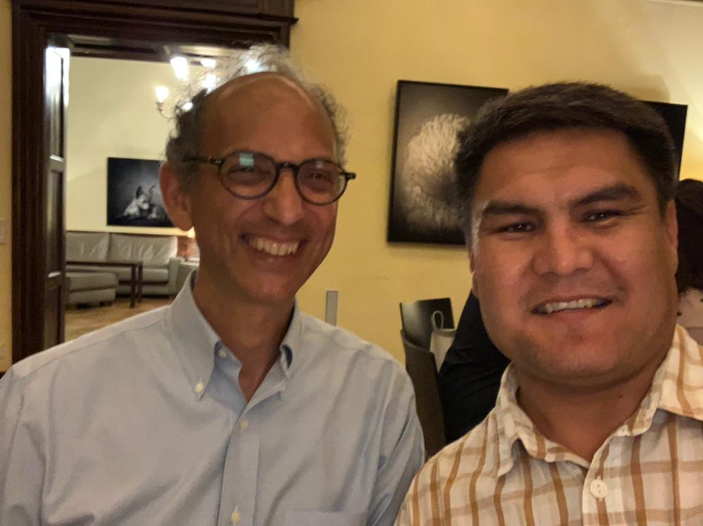
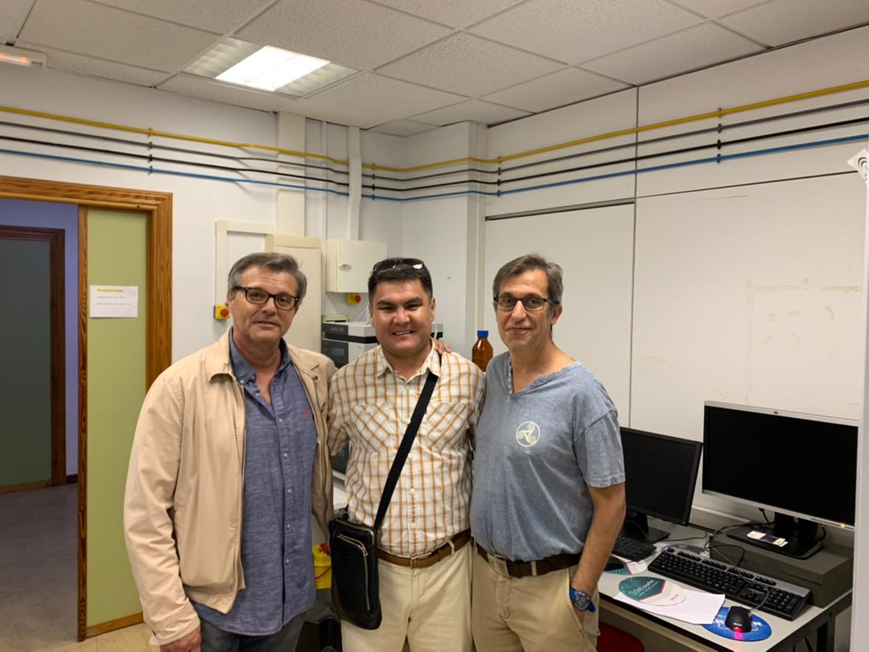
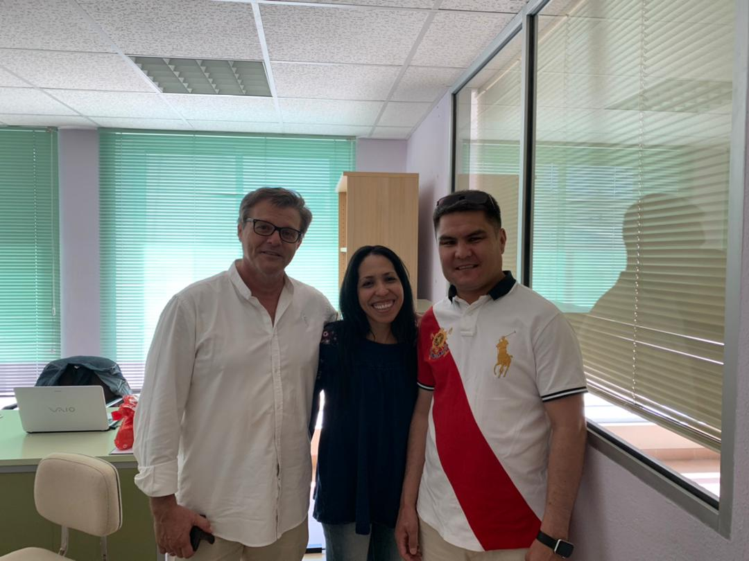
Traineeship
2011 - RUDN, Moscow – seminar
2013 - University of Tsukuba, Japan – workshop
2013, 2017 - University of Milan, Italy - Public Health Workshop.
2013, 2017 - University of Tartu, Estonia - Public Health Workshop.
2013 - Sangrenska University, Sweden - Public Health Workshop.
2015 - Universities of Munich, Jena, Kiel, Germany - DAAD Scholar
2015 - Nazarbayev University, Astana - Forum of Young Leaders
2015 - Ata-Turk University, Turkey – lecturer
2016, 2018 - India, Delhi - member of the Cooperation Council
2016 - Adnan Menderes Turkey, Ak-Deniz Antalya – lecturer
2017 - Berlin Technical University, Germany - Blended Learning Workshop
2017 - Lugano, Switzerland - eHealth Summer School
2018 - Technical University of Cluj-Napoca, Romania - Seminar on Management in Health Care
2018 - Institute for Applied Technologies Zwickau, Germany - seminar on digitalization in the health care system
2018 - Jumhuriyet University, Sivas, Turkey - Lecturer on the Erasmus Plus program.
2019 - University of Cadiz, Spain - trainer, teacher in the Erasmus plus program.
2019 - Salzburg, Austria - seminar for pathologists2020 - Fetal Medicine Foundation, London, England - Webinar Series

Slide 6
Phone number: +996770450654
Email: rkalmatov@oshsu.kg
Current work place: Osh State University

